Slide 1
Methodological Issues in Learning Analytics: Critical Insights and Reflections
Professor Mark Brown
Nancy, France
22th May 2017

Slide 5
Chair, Digital Learning
Director, National Institute for Digital Learning
@mbrownz

Slide 8
http://y1feedback.ie/predicted-using-vle-data-to-provide-weekly-automated-feedback-on-student-engagement/

Slide 9
https://predictedanalytics.wordpress.com

Slide 10
In short…
A pilot learning analytics project using LMS data on learner activity to provide direct feedback to students and lecturers during Semester.

Slide 11
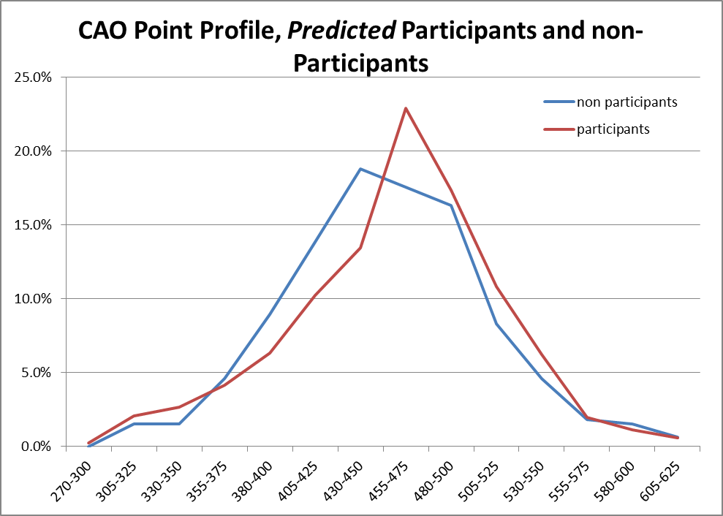
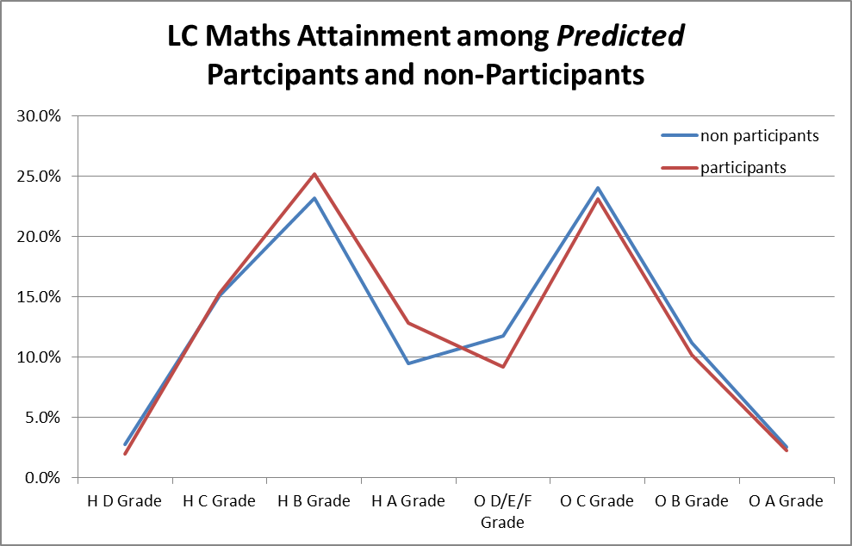
Participant Profile
No significant difference in the entry profiles of participants vs. non-participants overall

Slide 12
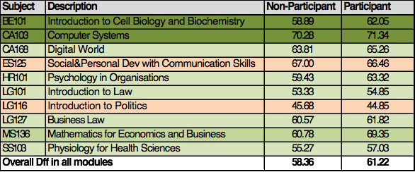
Academic Performance
Average scores for participants are higher in 8 of the 10 modules analysed.

Slide 13
Survey findings...
Question | Group 1 (more detailed email) | Group 2
% of respondents who opted out of PredictED during the course of the semester | 4.5% | 4.5%
% who changed their LMS usage as a result of the weekly emails | 43.3% | 28.9%
% who would take part again/are offered and are taking part again | 72.2% (45.6%/ 26.6% ) | 76.6% (46% /30.6% )

Slide 14
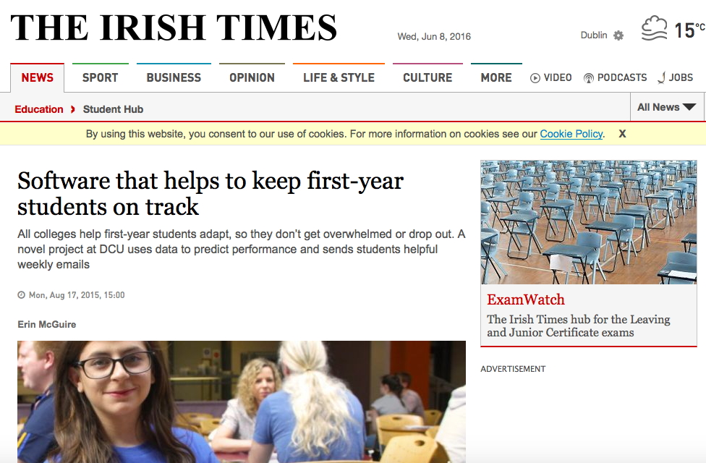

Slide 15
Three comments…

Slide 16
“Not everything that can be counted counts, not everything that counts can be counted.”
Albert Einstein

Slide 17
The Hype Gap

Slide 19
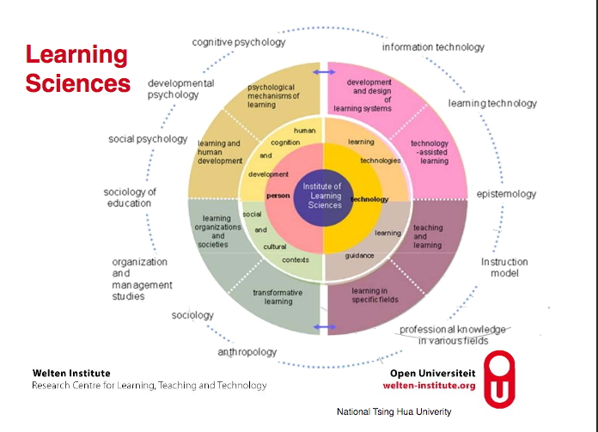

Slide 20
view education as a simple process that is easily modelled;
base decisions and interventions on data rich but weak theory;
inform decisions and interventions based on wrong or even invalid variables;
make interpretations and arrive at conclusions that confuse correlations with causality; and
result in unintended and unwanted effects that pigeonhole and stereotype learners which may be counterproductive to learner success.

Slide 22
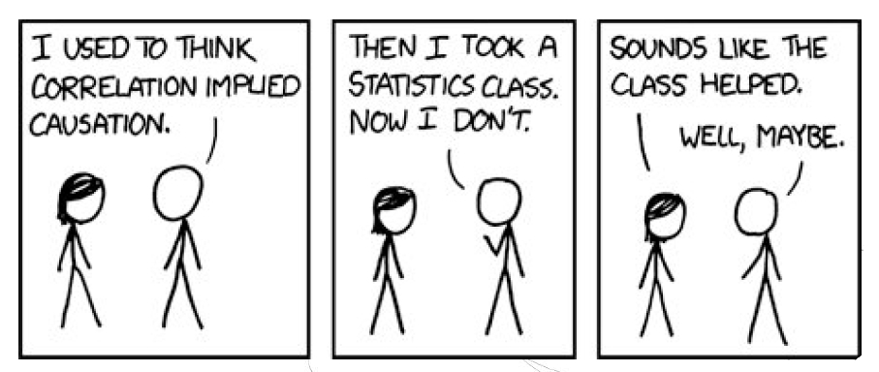

Slide 23
2. Novelty and Impact Bias

Slide 24
Allen, K., Galvis, D., Katz R. (2004). Evaluation of CDs and chewing gum in teaching dental anatomy. Journal of Dental Research, 83.
Learning
is like
chewing gum
(messy)
VS.

Slide 25
Survey findings...
Question | Group 1 (more detailed email) | Group 2
% of respondents who opted out of PredictED during the course of the semester | 4.5% | 4.5%
% who changed their LMS usage as a result of the weekly emails | 43.3% | 28.9%
% who would take part again/are offered and are taking part again | 72.2% (45.6%/ 26.6% ) | 76.6% (46% /30.6% )
13% Response

Slide 27
3. Border Crossing the Literature

Slide 29
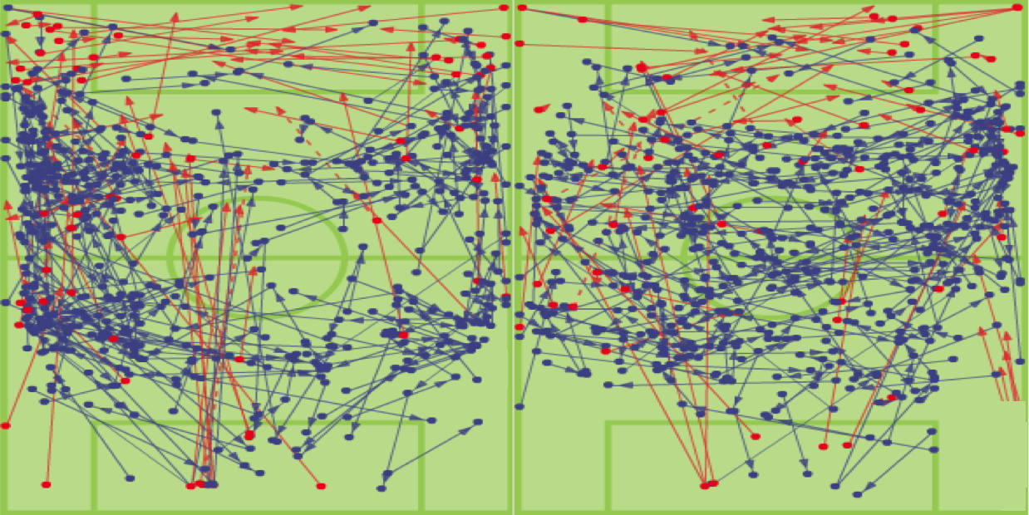
Performance takes place in the Network

Slide 31
http://studentsuccess.ie

Slide 32
Conclusion

Slide 33
Conclusion

Slide 34
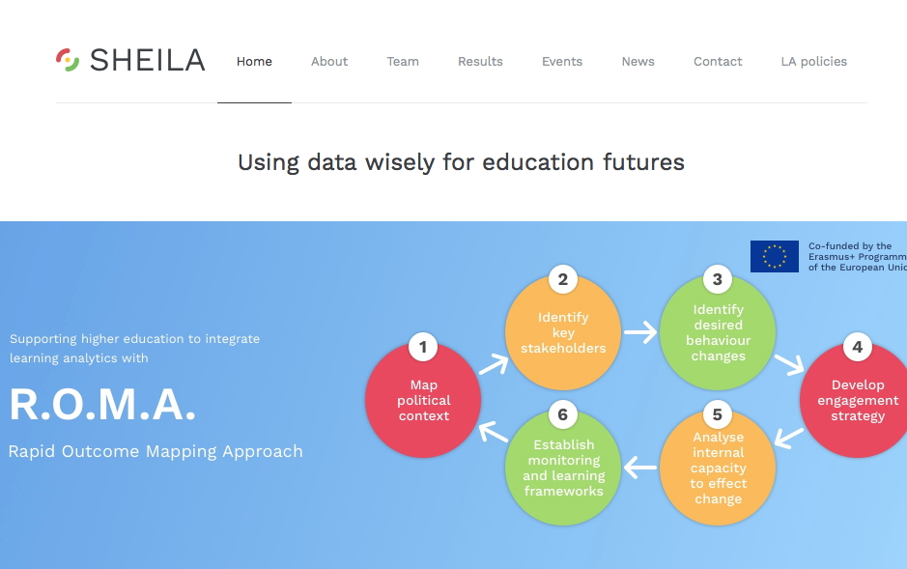

Slide 36
“A prudent question is one-half of wisdom”
Francis Bacon
http://www.slideshare.net/mbrownz
Questions…

Slide 37
Professor Mark Brown
Director, National Institute for Digital Learning
mark.brown@dcu.ie
www.dcu.ie/nidl
www.slideshare.net/mbrownz
@mbrownz

