Slide 1
Institutional Analytics in SUSS:
Objectives, Methodology, Progress & Challenges

Slide 2
Discussion Items
Objectives of Institutional Analytics in SUSS
Methodology: Structure, Data, Competencies & Projects Progress to Date Challenges and Future Directions

Slide 3
Objectives
The Institutional Research & Analytics Unit (IRAU) was set up in August 2016 to:
a) build up the University’s analytics capability;
b) undertake/facilitate analytics projects;
c) develop a platform to facilitate information sharing and decision making; and
d) digitally “warehouse” critical data.
Training & Learning?
Institutional & Unit Projects?
Dashboards & Deployment?
Integrated information System?

Slide 4
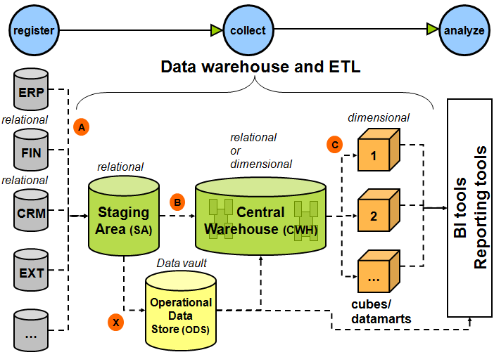
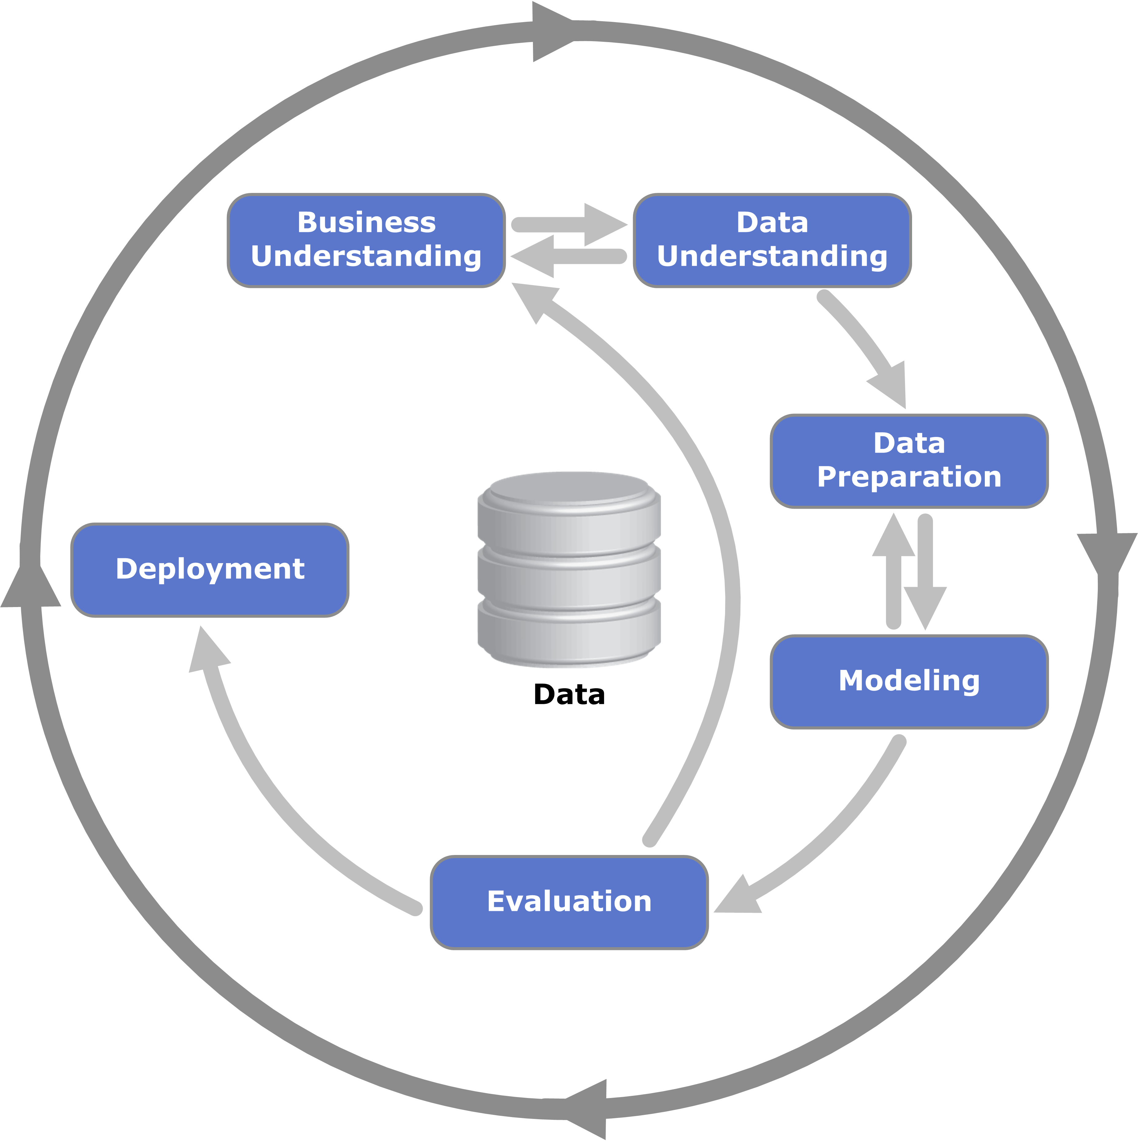
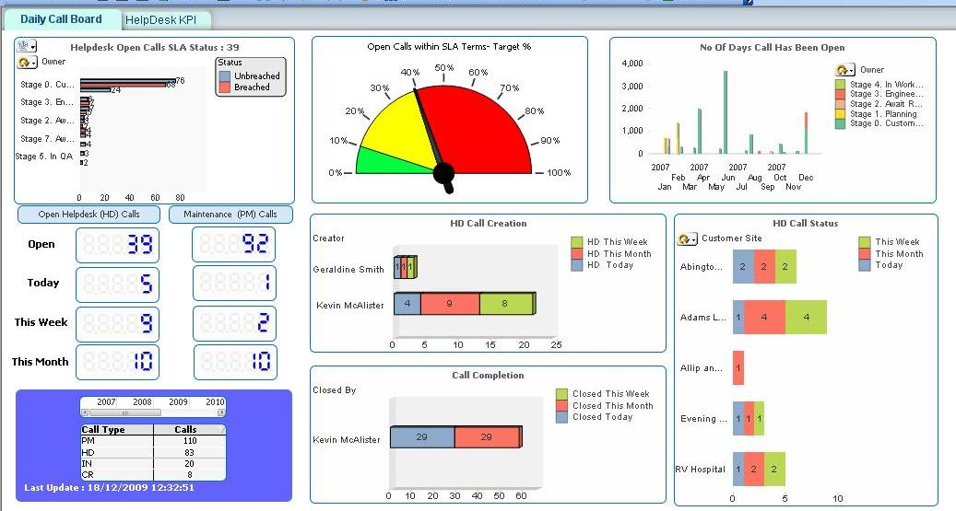
Methodology
IRAU Structure
Head, Faculty & Admin Support
DW Architect & Developer
Research Analysts & Associates
Institutional Research
Reporting Infrastructure
Data Warehouse
Analytics Infrastructure
Integrated Information System

Slide 5
Objectives and Methodology Alignment
University Level Decision Making & Planning
Support
Data Warehouse
IRAU
Reporting/
Analytics
Institutional Research
Support
Data, Training, Consultancy, Collaboration & Others
Support
Decision Making & Planning in Different Units in SUSS

Slide 6
Progress
Students:
At-risk, LMS & performance
(PT & FT)
Associates (i.e., PT instructors)
Others (e.g., TLC & external)
Internal:
Group & self learning
External:
Stages 1-3 (projects)
Training & Learning?
Institutional & Unit Projects?
Reporting:
Dashboards
Analytics:
DM projects
Dashboards & Deployment?
Data Warehouse
Hardware
Software
Integrated information System?

Slide 7
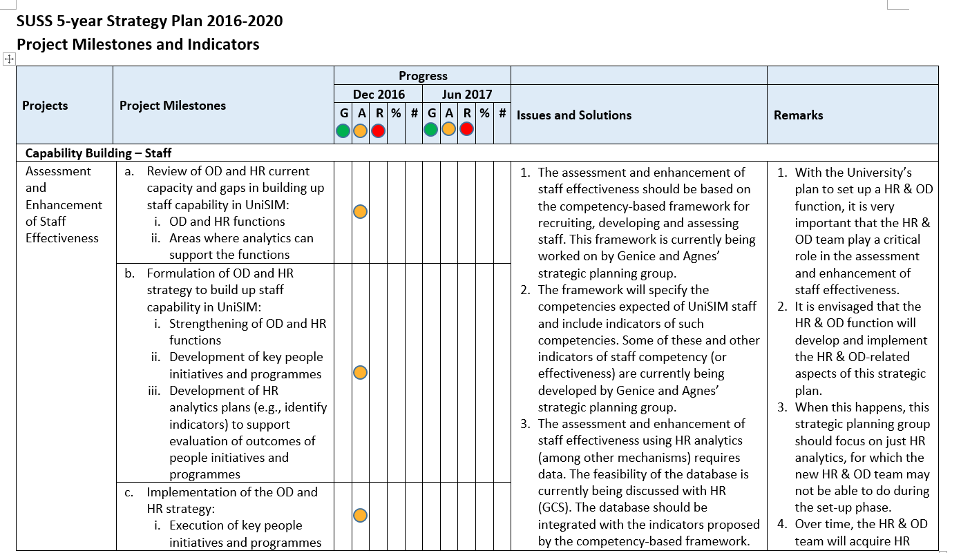
Progress – LA Framework & HR Strategic Plan
Development of HR analytics plans (e.g., identify indicators) to support evaluation of outcomes of people initiatives and programmes

Slide 8
Challenges and Future Directions
How to build up analytics capabilities?
Why should decision makers use analytics?
How to ensure data integrity?
Make owners responsible
Demonstrate usefulness via low-hanging fruits
Mentor, coach and provide apprenticeship
Develop strategies (KPIs) & frameworks; implement projects

Slide 9
Thank you Q & A

