Slide 1
What can Arficial Intelligence bring to Education?
François Bouchet
LIP6 / UPMC
francois.bouchet@lip6.fr
May 21st 2017
Nancy
Notes:
Hello everyone, thank you for being there so early on a Sunday morning. I’m François Bouchet, I’m an associate professor at Sorbonne University in Paris and today with you I’ll try to address this exciting question: what can AI bring to Education?

Slide 2
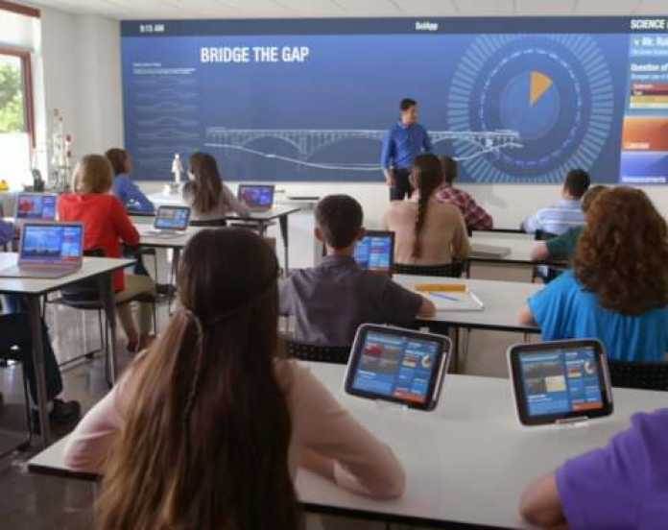
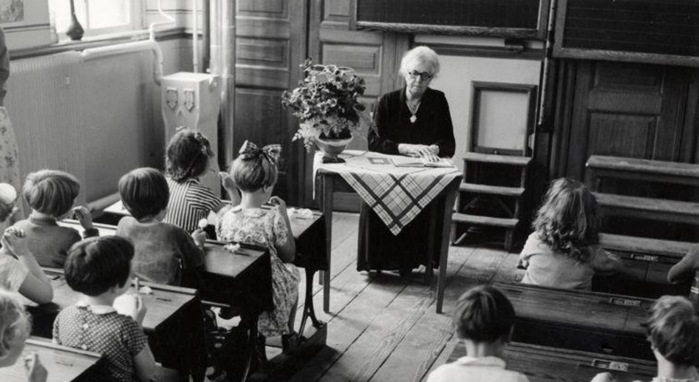
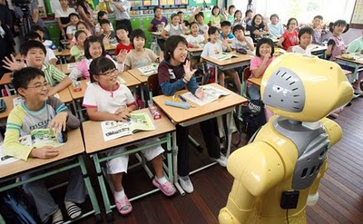
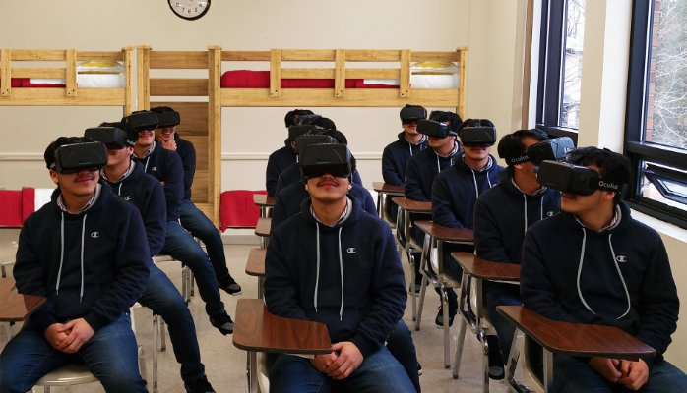
The cliché
Why so little change?
Notes:
Typically, in such a presentation, I could start by saying that we can see the gap is not that huge between this… and this… A bit more colorful, the teacher is a little more cheerful, there is a bit of technology, but even the flower pot is still there!
So then I’d tell you, and maybe that’s what you’re expecting to hear, why not more of this… fancy technological devices everywhere…. Or this… robot teachers… or this… VR everywhere!
And don’t get me wrong, for some particular applications, these visions CAN be interesting. But the point is not technology in itself, it is to have technology properly used when it’s needed. And more often than not, the impact AI can have on education will be subtle from an external point of view (as opposed to these radical photos), yet profound in changing the educational practices, hopefully for the best

Slide 3
The right questions
What is AIED?
What can it bring?
How?
How to connect AI to teaching and learning?
Risk: adapting to what is liked, not what is learned
Making an impact at the right level: teachers & students level
Risk: more efficient administration, not more efficient learning
Ethics: what acceptable uses?
Risk: new ideas once the data is there
Notes:
You’re leaders, and I’m sure you have seen in other presentations how research in learning analytics for instance can help you get a better vision on how to administrate a set of courses, a faculty… and those are useful goals indeed. But we are working in a special field, and while management is needed, in the end of the day, this is all about education and about empowering the people who make it: teachers, who are here to transmit their skills and knowledge, and students, who are here to acquire it.
Smarter technologies for better teaching and better learning

Slide 4
Goals today
Not replacing the teachers: harness the strengths of AI to empower them
Learning that is more:
Personalized
Flexible
Inclusive
Engaging
Respond to what is being learned, how it’s being learned, what is felt…
The dilemma:
Decades of research: great ideas are there
(Cheap) technological devices are there
Practical applications… not so much

Slide 5
What is AI?
Not easy to define
AI is shifting:
New, exciting, magical… « AI »
Common, invisible… « algorithm », « app »
Systems designed to interact with the world through capabilities and intelligent behaviors that are « human-like »
Notes:
Many of the apps you use everyday on your cellphones rely on algorithms that are definitely coming from AI:
When you want to watch a movie, and that your favorite app recommends you a new movie to watch: this is AI,
When you go to your favorite social network to post a couple of photos and it recognize faces to tag your friends: this is AI,
When you talk to your phone to interact with it: this definitely relies on a lot of techniques coming from AI
When you play to some strategy games against the computer: it depends on the game, but there can certainly be some real AI involved

Slide 6
But what about…
« General AI » can do everything a human can do,
at least as well as a human does it
Notes:
This guy?
Well, he definitely is AI. But something we would call « general AI »
And for now, general AI is not there. And we don’t need to have it for AI to be useful to education.
The whole point of this analogy is to show you that AI has already impacted our everyday life: we do things more easily thanks to it, and likewise AI in education should be implemented as « apps », algorithms here and there in various aspects of the learning and teaching experience that just make it smoother, easier and overall more enjoyable. So let’s get back to it!

Slide 7
What is AIED?
30 years of research
AI + learning sciences (education, psychology, neuroscience, linguistics, sociology) to promote adaptive learning environments
Goal: opening the black box of learning
Methods:
Using theories
Building models (knowledge about the world)
Process with algorithm
Testing
Iterating
Notes:
AI, which is itself interdisciplinary,

Slide 8
What models?
Pedagogical model: how to teach
Productive failures (mistakes are ok)
Appropriate feedback (which hints, when…?)
Testing knowledge (how?)
Domain model: what to teach
Learner model: students’ status (frequent update)
Achievements, skills, difficulties
Emotional state
Engagement (time on task)
Other models: metacognitive, emotional, social…
Notes:
Domain model: how to add/subtract numbers, thermodynamics, causes of World War II, how to structure an argument…
And of course models interact with each other: depending on the learner model, the pedagogical model can detect that an intervention is needed, which will then change the student’s status, which will be monitored by the learner model, and so on

Slide 9
A typical AI-driven learning environment
Updates
Domain model
Pedagogical model
Algorithms:
decision making process
Learner model
Students’ actions,
Affect,
Speech…
Adaptive learning environment
Learning content individualized
x
Open
Learner
Model
Logs
Updates
Feedback
Algorithms:
data analysis

Slide 10
Current uses of AI for Education
Personal tutors (ITS)
Intelligent support for collaborative learning (CSCL)
Intelligent virtual reality

Slide 11
Personal tutors : intelligent tutoring systems
Individualized tutoring: an ideal but cannot scale… until now
Different pedagogical approaches:
Scaffolding learning: between support and challenge
Diagnosing procedural errors (BUGGY)
Helping learners to be in control: self-regulated learning
« learning how to learn » (MetaTutor) (Azevedo et al. 2013)
Different methods to get there:
Symbolical:
requires experts
uses models, ontologies…
Numerical:
requires data
uses self-training algorithm (machine learning)
Hard to build
Hard to interpret

Slide 12
Supporting colloborative learning
Collaboration helps learning:
Pair of students in online courses have higher learning outcomes than students learning alone
Encourages reflexion
Caring about the group increases engagement
AI can help:
To form efficient groups with complementary skills (Labarthe et al. 2016)
Identify efficient collaborative patterns (to help students or teachers)
Through pedagogical agents: tutor (AutoTutor), peer (learning by teaching (Betty’s Brain)(Biswas et al. 2012))
Intelligent moderation: detect off topic discussions

Slide 13
Intelligent virtual reality
VR can help with learning:
Encouraging « what if » scenarios (simulation)
Visiting historical places
Enabling low-achieving students by shifting their self image (Crystal Island)
AI can make virtual world « intelligent »:
Guiding learners to regulate their emotional status
Encouraging collaboration between learners
Applications:
Against bullying (FearNot!) (Vannini et al. 2011)
Peacekeeping scenarios (Traum et al. 2003)

Slide 14
Future uses of AI for Education ?
Where is AI going?
What are the challenges?
Develop reliable indicators to track progress
More and more capture devices (biological data, eyetracking, speech recognition…)
Better understanding of the best teaching approaches and their context
More data collected + sharing

Slide 15
« A Renaissance in Assessment »
(Hill and Barber, 2014)
Just-in-time assessments
Today: LA can predict if a student will fail or drop-out
Tomorrow: how motivation and engagement varies
Tracking learning progress
Today: is the answer right/wrong?
Tomorrow: why? What type of mistakes? What emotional state?
Stealth assessments:
Today: short quizzes, final exam
Tomorrow: assessing while learning is happening (e.g. through a collaborative project)

Slide 16
New insights from learning sciences
AIED will be more interdisciplinary than ever
Education neuroscience:
Today: Uncertain rewards can improve learning (Howard-Jones et al., 2014)
Tomorrow: calibrating rewards based on learner
Psychology:
Today: « growth mindset » in learners is more efficient than « fixed mindset » (static intelligence) (Dweck, 2010)
Tomorrow: detecting student’s mindset and develop it

Slide 17
Lifelong learning partners
We learn more efficiently with another (Cole, 1996)
Today: learner-companion help stimulate student learning in various ITS
Tomorrow: one assistant companion
Across app and devices
In and beyond school
Choosing the optimal resources when they are needed

Slide 18
Tackling unsolved issues
Achievement gap – a social issue:
Help those who need it the most with one-on-one tutoring
Making sure all benefits from AIED
Developing teacher expertise:
Reducing stress
Freeing time to do what humans do best with students (automatic grading, resource recommendations…)

Slide 19
What about ethics?
Overall problem with data collection:
For what? For whom? Who decides?
Problem with algorithms:
What happens when AI goes wrong?
Who is responsible?
Sharing is necessary for AIED to be successful
Guaranteed anonymousness (privacy by design)
AIED encourages human behavior changes & to establish relationships
Should every mistake be reported to the teacher?
Spy effect

Slide 20
Conclusion
AIED exists today, and will be more and more important in years to come
It needs institutional support to spread:
Involve learners, teachers, parents in the co-design of the next AIED systems to meet their needs
Develop, evaluate… iterate
Spread data standards
Share data, but keeping the ethics in mind!
The potential gain is too important to ignore the opportunity!

