Slide 1
@DebJArnold
#eL4w
#dtransform
Soft skills, Employability and Digital Education
Deborah Arnold, AUNEGE-Université de Bourgogne, France Gérard Casanova, AUNEGE-Université de Lorraine, France
Joint session eLene4work /
2nd D-Transform leadership school
Nancy, Saturday 20th May 2017

Slide 2
eLene4work - Why do young people need Soft Skills and Digital Soft Skills?
Soft skills linked to employability, especially young people entering the job market European Commission, 2012 ; European Economic and Social Committee, 2010, Deloitte, 2011 ; SFOL,2012 ; IUL, CRUI, & Centromarca, 2012 ; Manpower Group, 2012.
By 2020, 90% of jobs will require digital skills
74% of universities consider they prepare their graduates well for the world of work, but only 38% of students and 35% of employers.
McKinsey (2014). ‘Education to Employment, getting Europe’s youth into work’, ILO Global Employment Trend.
This project has been funded by the Erasmus + programme of the European Union.

Slide 3
eLene4work - Understanding the notions of Soft Skills and Digital Soft Skills
Little consensus:
Different terms:
Soft skills, wicked skills Knight & Page (2007)
Transversal skills, non-technical skills, 21st century skills
Different understandings:
Digital skills ≠ computing skills
Work-related competences ≠ Transversal competences
Ex. community management
Open for debate:
Can the so-called ‘personal skills’ be learnt?
Is it the role of Higher Education to teach soft skills?
This project has been funded by the Erasmus + programme of the European Union.

Slide 4
eLene4work - Understanding the notions of Soft Skills and Digital Soft Skills
“Soft Skills represent a dynamic combination of cognitive and meta-cognitive skills, interpersonal, intellectual and practical skills. Soft skills help people to adapt and behave positively so that they can deal effectively with the challenges of their professional and everyday life.”
ModEs project (Haselberger et al., 2012; Cinque, 2012)
This project has been funded by the Erasmus + programme of the European Union.

Slide 5
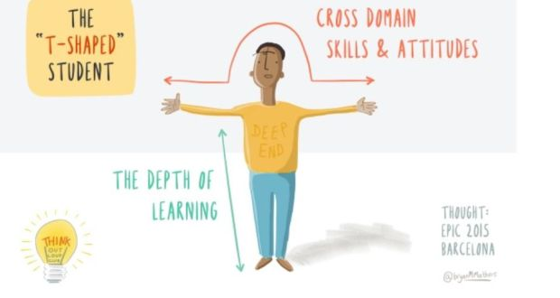
Soft Skills and the T-shaped graduate
Prof Brian MacCraith, President of Dublin City University
http://www.irishtimes.com/news/education/why-we-need-more-t-shaped-graduates-1.2584765 (29/03/2016)
Illustration: Bryan M Mathers
This project has been funded by the Erasmus + programme of the European Union.

Slide 6
eLene4work - Why do young people need Soft Skills and Digital Soft Skills?
2016 Pew Research Center survey “The State of American Jobs”: http://www.pewinternet.org/2017/05/03/the-future-of-jobs-and-jobs-training/
“Employment is much higher among jobs that require an average or above-average level of preparation (including education, experience and job training); average or above average interpersonal, management and communication skills; and higher levels of analytical skills such as critical thinking and computer skills”
In the next 10 years, do you think we will see the emergence of new educational and training programs that can successfully train large numbers of workers in the skills they will need to perform the jobs of the future?
This project has been funded by the Erasmus + programme of the European Union.

Slide 7
Group work
FIRST STEP :
Discuss in your group and try to answer to the question :
In the next 10 years, do you think we will see the emergence of new educational and training programs that can successfully train large numbers of workers in the skills they will need to perform the jobs of the future?
This project has been funded by the Erasmus + programme of the European Union.

Slide 8
Group work
SECOND STEP :
From the eLene4work soft skills framework, which are the most important for employability?
Vote with your
Identify the 3 skills with the highest score
Distribute your stickers about the skills you have identified
As you want (all on one , equitably distribued
overall ranking (top 3)
Make the total of stickers
Define the ranking of your group
Justify your group choice
This project has been funded by the Erasmus + programme of the European Union.

Slide 9
Group work
From the eLene4work soft skills framework, which are the most important for employability?
Vote with your
Identify the 3 skills with the highest score
Rank these from 1 to 3 1 = most important ; 3 = least important)
Share your results with the group => overall ranking (top 3)
This project has been funded by the Erasmus + programme of the European Union.

