Slide 1

Learning Analytics: Involvement of Teachers, Students and Staff
Wim Van Petegem
Professor KU Leuven
Vice-President EDEN

Slide 2
Students and their characterics

Slide 3
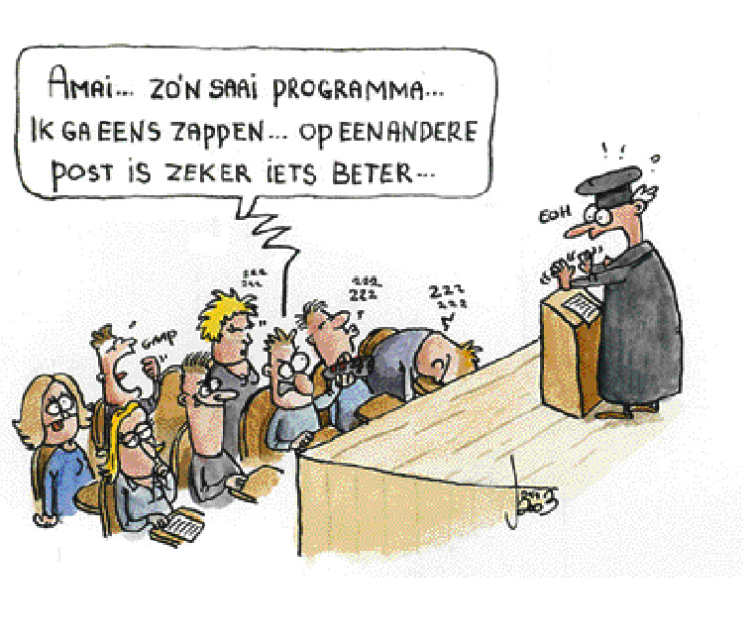
Learners say: “Challenge us!”
What a boring program… Let’s switch to another channel…

Slide 4
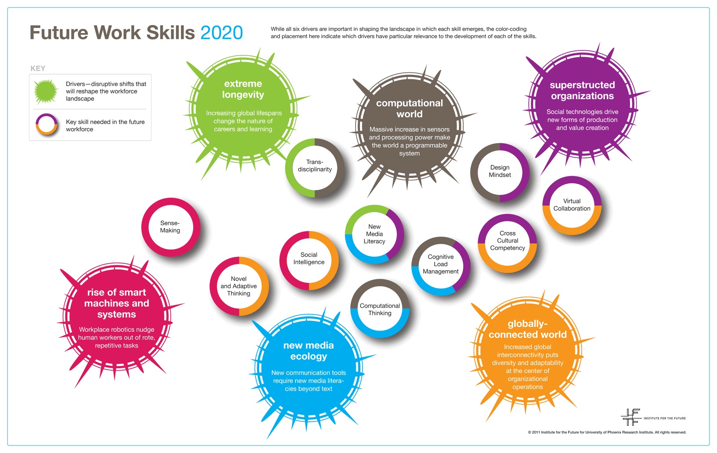

Slide 5
Technology for Innovation

Slide 6
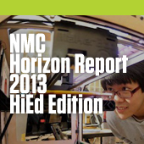
Technology trends
Time-to-Adoption Horizon: <1 Year
  MOOCs
  Tablet Computing
Time-to-Adoption Horizon: 2-3 Years
  Game-Based Learning
  Learning Analytics
Time-to-Adoption Horizon: 4-5 Years
  3D Printing
  Wearable Technology

Slide 7

Technology trends anno 2014
Important Developments in Educational Technology for Higher Education
Time-to-Adoption Horizon: One Year or Less
  Flipped Classroom
  Learning Analytics
Time-to-Adoption Horizon: Two to Three Years
  3D Printing
  Games and Gamification
Time-to-Adoption Horizon: Four to Five Years
  Quantified Self
  Virtual Assistants

Slide 8

Technology trends anno 2015
Important Developments in Educational Technology for Higher Education
Time-to-Adoption Horizon: One Year or Less
  Flipped Classroom
  BYOD
Time-to-Adoption Horizon: Two to Three Years
  Makerspaces
  Wearable Technologies
Time-to-Adoption Horizon: Four to Five Years
  Adaptive Learning Technologies
  The Internet of Things

Slide 9

Technology trends anno 2016 (III)
Important Developments in Educational Technology for Higher Education
Time-to-Adoption Horizon: One Year or Less
  Bring Your Own Device (BYOD)
  Learning Analytics and Adaptive Learning
Time-to-Adoption Horizon: Two to Three Years
  Augmented and Virtual Reality
  Makerspaces
Time-to-Adoption Horizon: Four to Five Years
  Affective Computing
  Robotics

Slide 10
Innovating Pedagogy

Slide 11
Innovating Pedagogy 2012
New pedagogy for e-books
Publisher-led short courses
Assessment for learning
Badges to accredit learning
MOOCs
Rebirth of academic publishing
Seamless learning
Learning analytics
Personal inquiry learning
Rhizomatic learning

Slide 12

Innovating Pedagogy 2013
MOOCs
Badges to accredit learning
Learning analytics
Seamless learning
Crowd learning
Digital scholarship
Geo-learning
Learning from gaming
Maker culture
Citizen inquiry

Slide 13

Innovating Pedagogy 2014
Massive open social learning
  Free online courses based on social learning
Learning design informed by analytics
  A productive cycle linking design and analysis of effective learning
Flipped classroom
  Blending learning inside and outside the classroom
Bring your own devices
  Learners use their personal tools to enhance learning in the classroom
Learning to learn
  Learning how to become an effective learner
…

Slide 14
Innovating Pedagogy 2014 (cont)
…
Dynamic assessment
  Giving the learner personalized assessment to support learning
Event-based learning
  Time-bounded learning events
Learning through storytelling
  Creating narratives of memories and events
Threshold concepts
  Troublesome concepts and tricky topics for learning
Bricolage
  Creative tinkering with resources

Slide 15

Innovating Pedagogy 2015
Crossover learning
  Connecting formal and informal learning
Learning through argumentation
  Developing skills of scientific argumentation
Incidental learning
  Harnessing unplanned or unintentional learning
Context-based learning
  How context shapes and is shaped by the process of learning
Computational thinking
  Solving problems using techniques from computing
…

Slide 16
Innovating Pedagogy 2015
Learning by doing science with remote labs
  Guided experiments on authentic scientific equipment
Embodied learning
  Making mind and body work together to support learning
Adaptive teaching
  Adapting computer-based teaching to the learner’s knowledge and action
Analytics of emotions
  Responding to the emotional states of students
Stealth assessment
  Unobtrusive assessment of learning processes

Slide 17
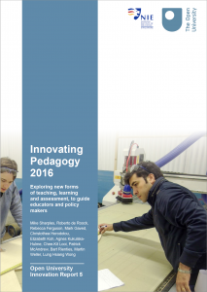
Innovating Pedagogy 2016
Learning through social media
  Using social media to offer long-term learning opportunities
Productive failure
  Drawing on experience to gain deeper understanding
Teachback
  Learning by explaining what we have been taught
Design thinking
  Applying design methods in order to solve problems
Learning from the crowd
  Using the public as a source of knowledge and opinion
…

Slide 18
Innovating Pedagogy 2016
…
Learning through video games
  Making learning fun, interactive and stimulating
Formative analytics
  Developing analytics that help learners to reflect and improve
Learning for the future
  Preparing students for work and life in an unpredictable future
Translanguaging
  Enriching learning through the use of multiple languages
Blockchain for learning
  Storing, validating and trading educational reputation

Slide 19
Innovating Learning in HE:
It’s all about change

Slide 20
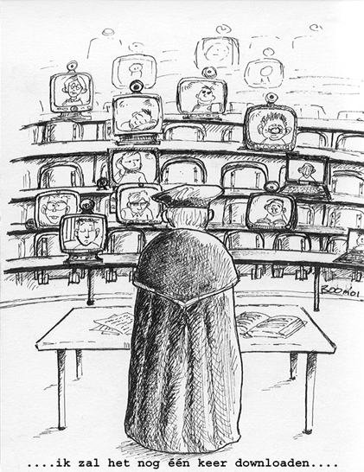
New type of universities?

Slide 21
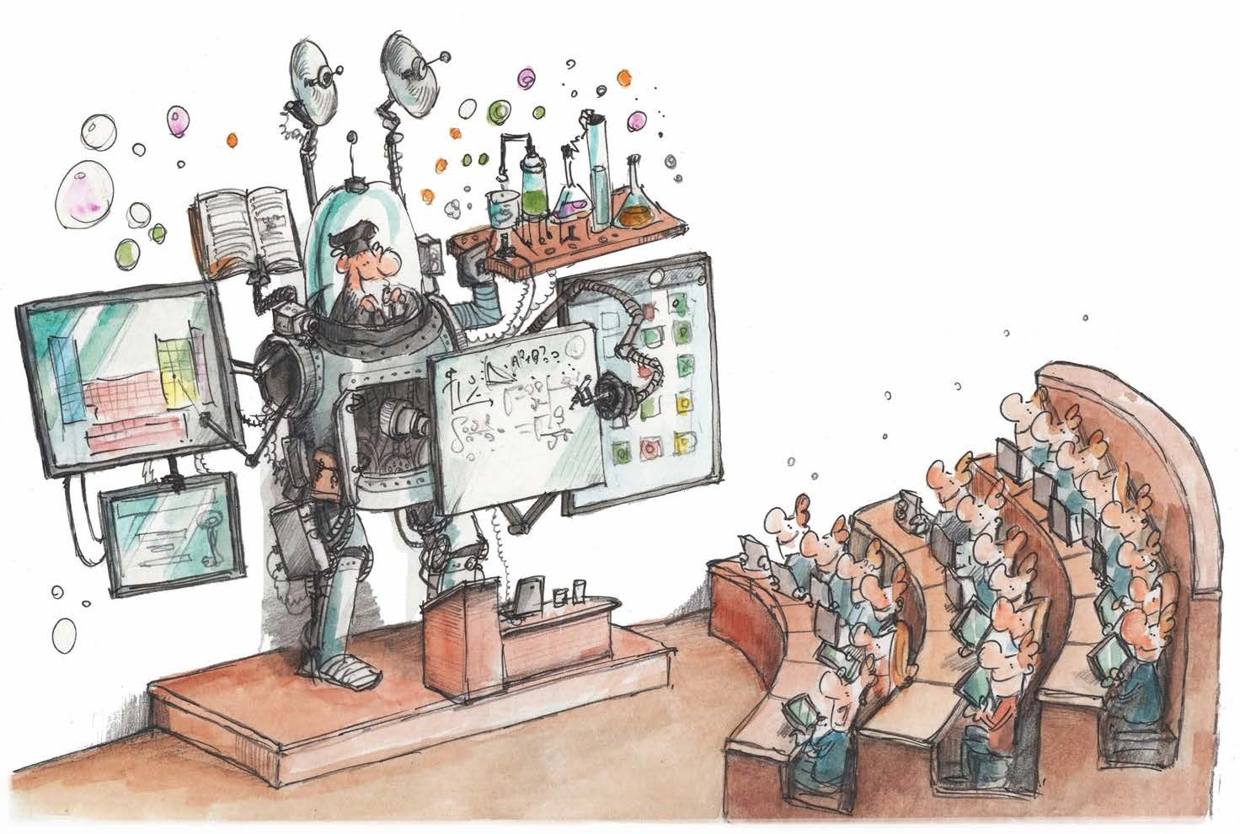
New ways of teaching and learning?
© Joris Snaet, KU Leuven

Slide 22
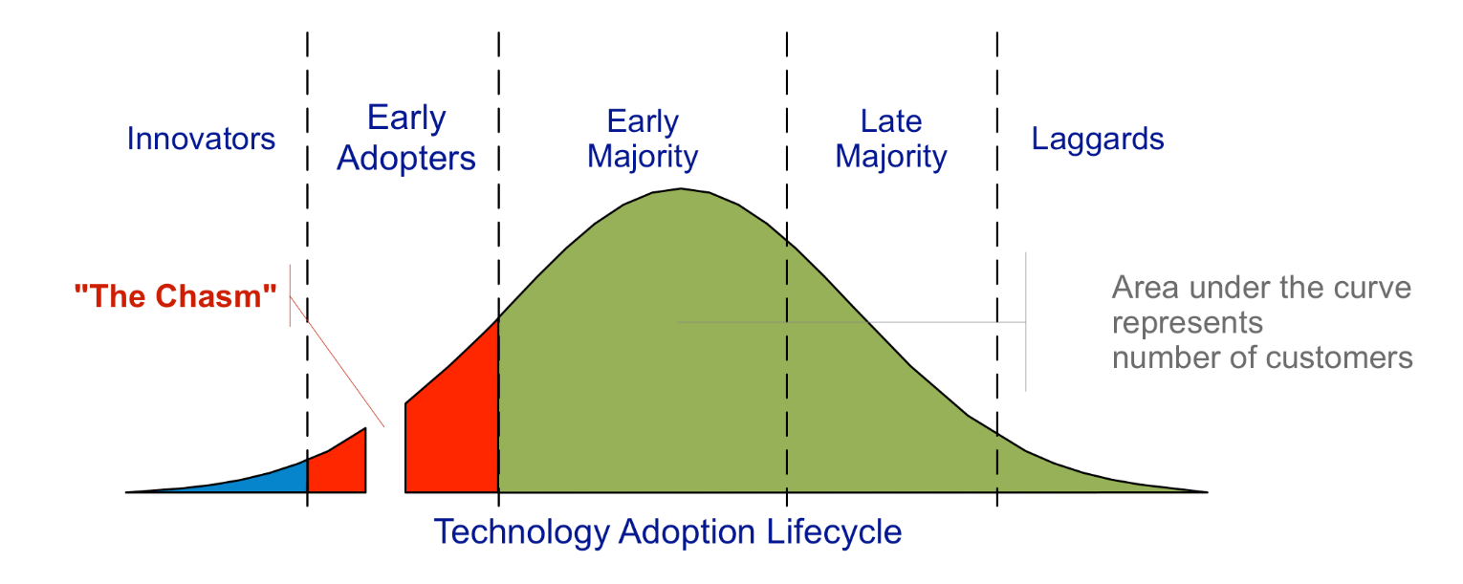
Technology Adoption Lifecycle

Slide 23
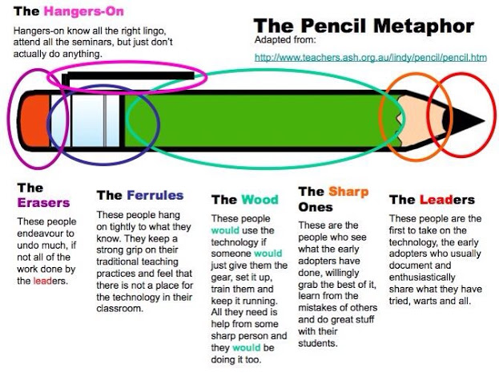
The Pencil Metaphore

Slide 24
Future directions?

Slide 25
Supporting a growing European community of interest in using data to improve education & training in schools, universities & the workplace

Slide 26
Mission
FP7 CSA – 30 months, Jan 14 – June 16
Spread information about best practice in the effective use of learning analytics
Build knowledge and skills amongst educational practitioners related to the ethical handling of data
Help shape future European research and innovation actions in this field

Slide 27

































Who we are now (51+ Ass. Partners)
LACE Network
LACE Consortium
Notes:
Add numbers for key indicators to slides

Slide 28
How to involve students?
Learners as…
Human beings
Consumers
Co-creators
Partners
Drivers
…
Learners, please, “challenge us”!!

Slide 29

Questions? Suggestions?

Slide 30
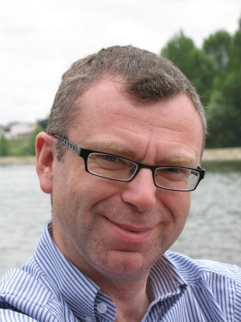
Info
Prof.dr.ir. Wim Van Petegem
Policy coordinator Learning Technologies
Faculty of Engineering Technology
KU Leuven
W. De Croylaan 56, B-3001 Heverlee (Belgium)
T: +32-16-32.78.13
F: +32-16-32.82.70
M: +32-477-77.22.86
S: wvanpetegem
E: wim.vanpetegem@kuleuven.be
L: http://be.linkedin.com/in/wimvanpetegem

