Slide 1
LEADERSHIP SCHOOL
Preparing Higher Education leaders to become the change makers of the university of tomorrow
D-TRANSFORM:
University strategies
in the digital age
A MOOC for supporting transition
17/11/2016 Susanna Sancassani, Politecnico di Milano - METID

Slide 2
Why a MOOC for supporting transition?

Slide 7
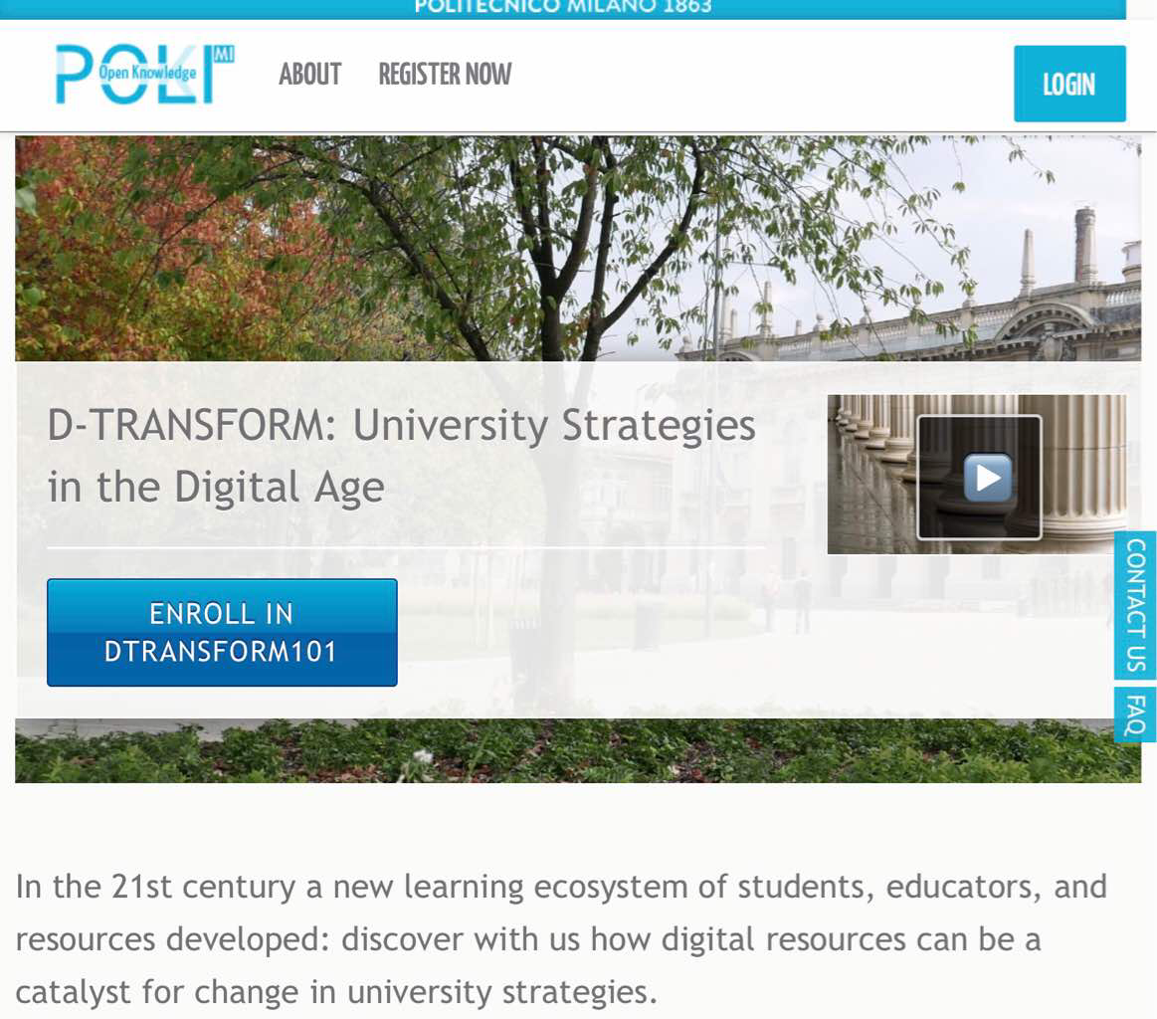
http://www.pok.polimi.it

Slide 8
4
Pillars

Slide 9
Simplicity

Slide 10
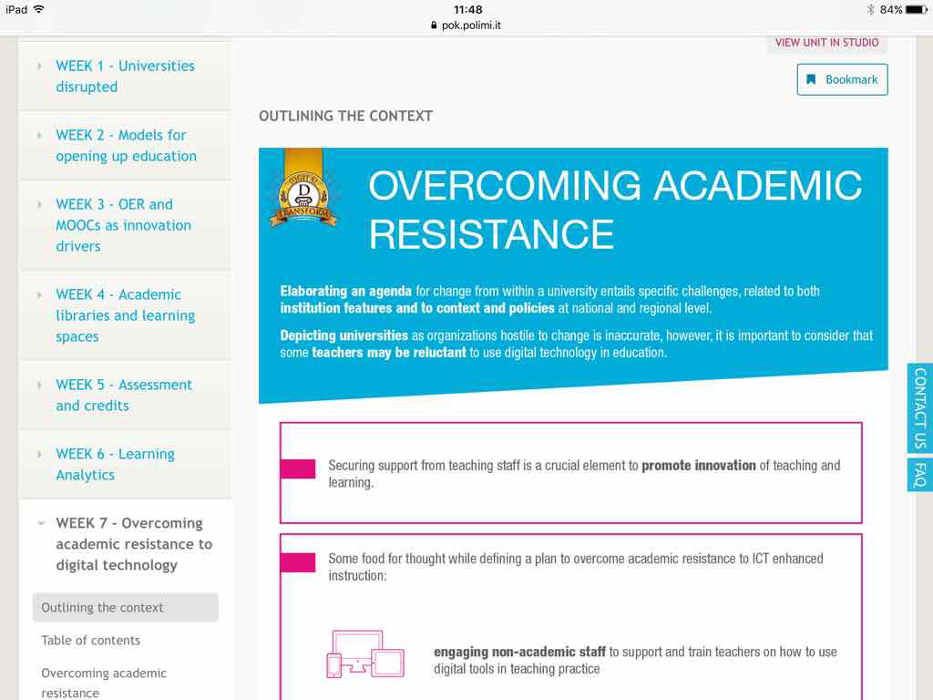

Slide 11
Quickness

Slide 12
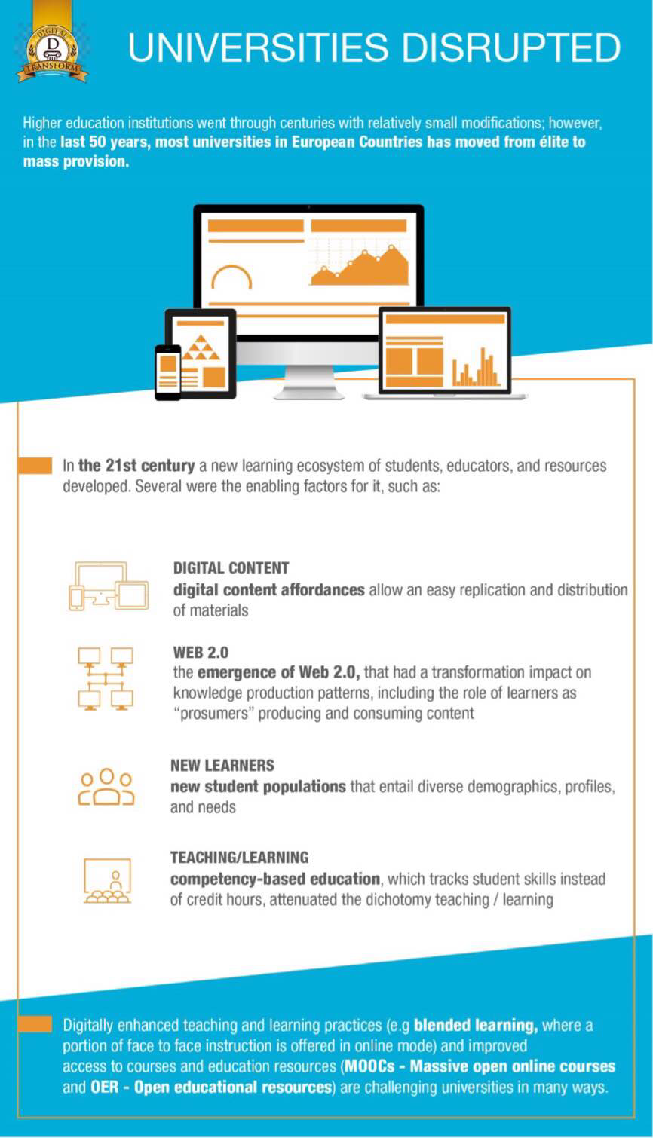

Slide 13
Openness

Slide 15
Multiplicity

Slide 16
Low budget

Slide 17
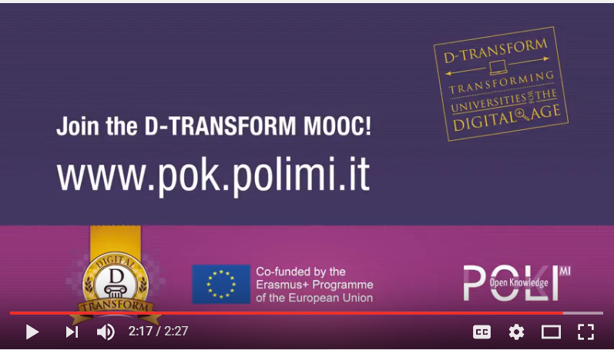

Slide 18
This project has been funded with support from the Erasmus+ Programme of the European Union. This site reflects only the views of the authors, and the European Union cannot be held responsible for any use which may be made of the information contained therein.
http://www.dtransform.eu/

